Slide 1
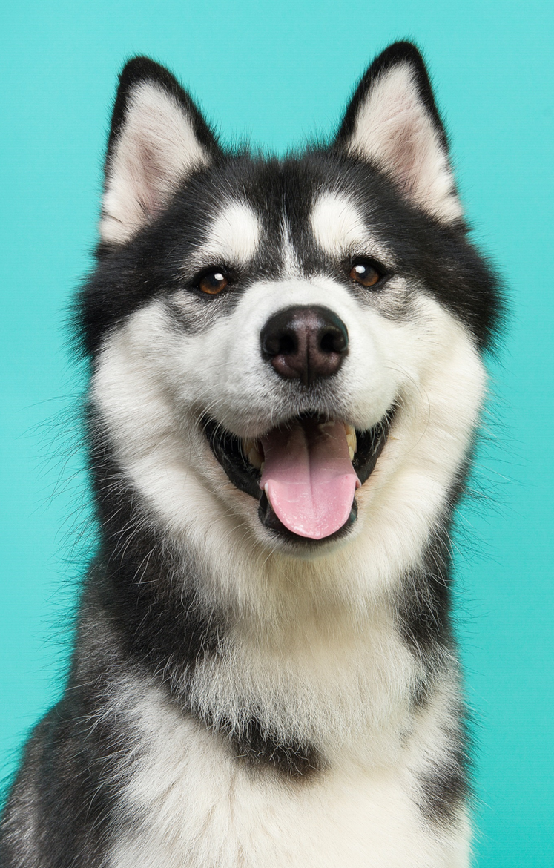
Luna
Certificate of Completion
is presented to
for their completion of the Good Dog course.
Francis Ribeiro
INSTRUCTOR
April 24, 20XX
Date

